Slide 1
xBRL-CSV Overview

Slide 2
xBRL-CSV
xBRL-CSV provides a flexible, standardised approach for XBRL data, built upon the Open Information Model (OIM) and the W3C’s Tabular Metadata specification

Slide 3
Why CSV?
Ubiquitous support
Very efficient for large data sets, particularly those with large volumes of repeating records
xBRL-CSV is aimed at bulk data collection and publication
Combines the benefits of the CSV data format with the rich metadata provided by XBRL

Slide 4
CSV: one size does not fit all
No single format of CSV document would be suitable for all types of XBRL Report
xBRL-CSV makes it possible to define the layout of CSV files (tables) using JSON metadata
JSON metadata file groups a set of CSV files, and defines the layout of each table and its mapping to XBRL
Metadata file uses & extends the W3C Tabular Metadata standard

Slide 5
xBRL-CSV: BUILDING A FACT
Fact = Value + Aspects
Aspects:
Concept
Period
Unit
Entity
Dimensions
Aspects can be defined on:
Columns (e.g. column of values for “Profit” concept)
Report (e.g. all facts have the same entity)
Table (e.g. facts for a particular dimension value)
Another cell in the same row
Aspects inherit and can be overridden (e.g. a default unit for all facts)

Slide 6
xBRL-CSV: Loan data example
Consider a simple report consisting of information about loans issued to a number of companies:

Slide 7
xBRL-CSV: Loan data example
Consider a simple report consisting of information about loans issued to a number of companies:
Let’s look at how this would be modelled in XBRL

Slide 8
xBRL-CSV: Loan data example
Facts

Slide 9
xBRL-CSV: Loan data example
Concepts
Facts

Slide 10
xBRL-CSV: Loan data example
Typed Dimension
Dimension values
Concepts
Facts

Slide 11
xBRL-CSV: Loan data example
Typed Dimension
Dimension values
Concepts
Facts
Standing data:
Report period start/end
Entity identifier

Slide 12
xBRL-CSV: Loan data example
Let’s look at the JSON metadata file needed to capture this using xBRL-CSV…

Slide 13
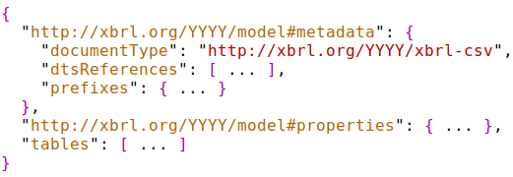
JSON metadata: Overview

Slide 14
JSON metadata: Overview
Boilerplate to identify the standard and version that this file conforms to.

Slide 15
JSON metadata: Overview
Identifies the taxonomy used by this report

Slide 16
JSON metadata: Overview
A set of bindings of namespace URIs to prefixes used within the report

Slide 17
JSON metadata: Overview
Report-level properties that provide default property values for all facts in all tables

Slide 18
JSON metadata: Overview
Metadata for each table (CSV file) in this report

Slide 19
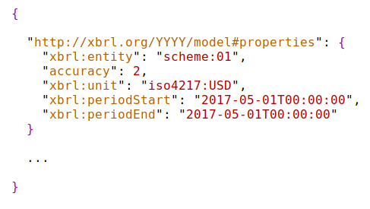
JSON metadata: report-level properties
Report-level properties provides standing data and defaults for all facts. Can be overridden at table, column or row level

Slide 20
JSON metadata: prefixes
Prefixes in xBRL-CSV use Simplified QNames (SQNames):
Analogous to prefixes in XML
Prefix:Namespace is 1:1 within a document
Local parts can be any token (so can be used for entity identifiers which often have a numeric first character)

Slide 21
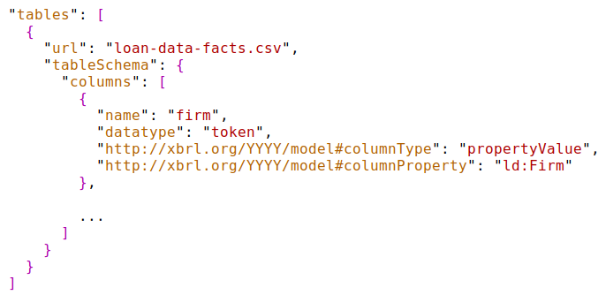
JSON metadata: tables
“tables” object provides information about each CSV file (table) in the report

Slide 22
JSON metadata: tables
Each table contains a set of column definitions.

Slide 23
JSON metadata: columns

Slide 24
JSON metadata: columns
Column type specifies that each cell in this column produces a numeric simple fact

Slide 25
JSON metadata: columns
Properties defined here are applied to all facts in this column

Slide 26
Column Types

Slide 27
Column Types
Numeric simple fact

Slide 28
Column Types
Numeric simple fact
Numeric simple fact
Numeric simple fact

Slide 29
Column Types
Simple fact
Simple fact
Numeric simple fact
Simple fact
Numeric simple fact
Numeric simple fact
Simple fact

Slide 30
Column Types
Simple fact
Simple fact
Numeric simple fact
Simple fact
Property value column
Numeric simple fact
Numeric simple fact
Simple fact

Slide 31
Column Types
Property value column
Let’s look at property value columns in a bit more detail

Slide 32
Property value columns
Values in first column provide a dimension value to facts created by other cells in the same row. This is handled in xBRL-CSV as a “property value column”

Slide 33
Property value columns
Dimension values
Values in first column provide a dimension value to facts created by other cells in the same row. This is handled in xBRL-CSV as a “property value column”

Slide 34
Property value columns
Dimension values
Facts
Values in first column provide a dimension value to facts created by other cells in the same row. This is handled in xBRL-CSV as a “property value column”

Slide 35
Property value columns
This is the column definition for the first column

Slide 36
Property value columns
C
Type of column

Slide 37
Property value columns
C
Name of aspect provided by this property value column (in this case, a typed dimension)

Slide 38
Property value columns

Slide 39
Property value columns

Slide 40
Property value columns
By default, property value is applied to all fact-producing cells in the same row, but it is possible to target it to specific columns.

Slide 41
loan-data-facts.csv
Compact representation
First row is ignored

Slide 42
Working with CSV data
xBRL-CSV is built upon the OIM
This enables lossless, standardised transformation to other formats, including:
xBRL-XML (the XBRL v2.1 XML syntax)
xBRL-JSON

Slide 43
Summary
xBRL-CSV provides a flexible, standardised format for representing XBRL data in CSV
Ideal for large quantities of repeating (record-based) data
Structure of CSV files defined in JSON metadata, re-using W3C standards
OIM ensures XBRL semantics are maintained
Currently at Public Working Draft status: comments and participating welcomed!

